Slide 1

Meeting of the UN Development System Africa Regional Task Team on the Regional Review
OIBC-1: Strengthened integrated data and statistical systems for sustainable development
Recommendation # 4: Strengthening the Data
Ecosystem
12 May 2020

Slide 2
Recommendation # 4 Strengthening Data Ecosystem
The SG requested a unique proposal from each region:
“I propose to launch a region-by-region change management process that will seek to consolidate existing capacities with regard to data and statistics, as well as other relevant analytical functions that may be currently duplicative. This exercise will have to be unique to each region and will be detailed and fleshed out in full consultation with each regional commission and respective regional team of the United Nations Sustainable Development Group. Any related changes to existing structures or budgets will be submitted to United Nations legislative committees for endorsement by Member States prior to implementation.” [A/74/73–E/2019/14, para. 115]’’

Slide 3
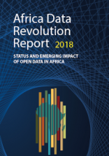
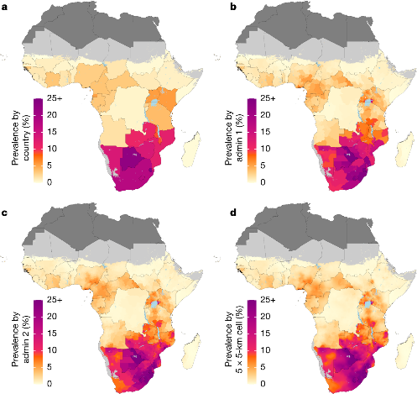


Challenges, Opportunities and Partnerships
Current Status and challenges
Opportunities
WEAK GOVERNANCE STRUCTURE & COORDINATION
Lack of harmonization of data
Weak system for data management
Weak demand and capacity to use data
Insufficient funding and dependence on external resources
Limited uptake of new technologies
Underutilized role of research and development
Partnerships & collaborations
Notes:
Data Revolution: A profound shift in the way that data is harnessed to impact on development decision-making, with a particular emphasis on building a culture of usage. The process of embracing a wide range of data communities and diverse range of data sources, tools, and innovative technologies, to provide disaggregated data for decision-making, service delivery and citizen engagement; and information for Africa.
Current status and challenges:
At the core is WEAK GOVERNANCE STRUCTURE & COORDINATION: politics of data, sovereignty, security, multiplicity of partnership, fragmentation.
Lack of harmonization of data: Uneven coverage, weak disaggregated, silos/sectoral, lack of timely, accurate, relevant, comparable disaggregated data
Weak system for data management: Concerns over privacy, data protection and intellectual property
Limited uptake of new technologies: poor infrastructures, wifi, internet, technologies.
Weak demand and capacity to use data: limited skills and knowhow by policy makers, managements and planners; lack of functioning M & E systems
Insufficient funding and dependence on external resources: Supply driven based on donor funding, Mismatch of available data and actual problems
fragmentation of data collection, harmonization, reporting with UNDS – resulting in reporting burden on NSOs
Opportunities for data revolution:
SHASA2 – Strategy for harmonization for statistical development in Africa
Existence of Africa Data Consensus – Result of STC meeting on data revolution on 2015.
Increased New Innovative technologies to monitor progress of SDGs
– GRID3/Population modelling, tablets, high resolutions imagery, big data, etc.
Existence of recently launch UN Data Strategy for Action for Everyone, by Everyone.
Partnership & collaboration
PARIS21 – (Partnership in Statistics for Development in the 21st Century) – partnership of development partners to that promote the better use of statistics for development – established by UN, WB, EC, OECD, IMF.
Center for SDG – research institution based in Rwanda + also mentioned others
Leverage on UNDS as a coalition, i.e. Africa Symposium for Statistical Development (ASSD), Statcom, and Regional Commissions Chief Statisticians regular meetings with DESA, Coordinating Committee on Statistical Activities (CCSA), UN Committee of Chief Statistician (UN -CCS)

Slide 4
Approach….
The UN Sustainable Development Group in Africa will work to develop strategies to generate and disseminate quality data and to improve the use of data for evidence-based decision-making leading to inclusive, sustainable and resilient societies in the region
Data – quality, accurate, relevant, timely, cost effective, disaggregated and accessible to all
Driven by innovation, robustness, online and digitization, integrated and harmonized approaches to respond to SDGs, Agenda 2063 and national development frameworks
Thus, imperative to design and deliver a ONE UN National Statistical Capacity Programme in all African countries to support the development of sustainable statistical system

Slide 5
Vision: An integrated and comprehensive data ecosystem that will support an effective implementation of Agenda 2030 for SDGs and Agenda 2063
Mission: To develop an integrated data ecosystem, that improves policy and programme delivery and effectiveness, through generation, dissemination and use of quality data to monitor progress and ensure achievement of the SDGs and Agenda 2063
Principles
Promote sustainability
Harness the power of Big data and innovation technologies
1
2
3
4
Coherence in statistical systems in order to generate reliable & comparable data
5
Advance rights for all &
Data privacy and sovereignty
Recognizes data as a public good and rights imperative

Slide 6
Proposed Flagship Initiatives
Transforming the National Statistical Systems in Africa
1. Develop procedures for adopting innovative methodologies - NSS to Go Digital
2. Design and deliver a ONE UN National Statistical Capacity Development Programme
Promote the culture of Data Use
Online Data Platform “Data Gateway”
Develop guidelines and strategies for promoting culture of data use
Develop criteria for identifying the Champion on Data for Development, including clear roles;
Develop a robust online data system with data at regional, country, subnational for all SDGs and Agenda 2063, that is harmonized with other data systems in Africa to continuously be accessible to provide quality data ecosystem

Slide 7










Data flows
DATA
PROCESSING
DATA DISSEMINAITON – “Gateway”
DATA COLLECTION
Censuses
Other
sources
Regional and sub-regional organizations
AUC, AFDB, RECs
SDG
tracking progress
Admin data
Surveys
Raw data flow
Processed data flow
SDG
report
Ad-hoc data flow
SDG
infographics
and visuals
Data quality assessment
Coordination
Methodology
Concepts
Capacity building
Ministries
SDG data
availability
report
Regional aggregates
SDG data
access via the web
Data
Custodian
Agencies
NSOs
National Statistical System
UNSD
Global SDG Indicators Database
Processed data
Central Banks
Harmonization
Methodology
Africa’s
processed data
Other data sources
SDGC/A
Data
Methodologies, concepts and metadata
Reports
SDG INDEX
SDG/A2063 Alignment Reports
Country SDGs Profile Data
Other custom reporting (VNR, etc.)
30% of the data of Agenda 2063 does not go through the custodian agencies
IPRT
SDG Progress
Assessment
Data

Slide 8
Strategies to ensure integrated data & statistical system for sustainable development
INNOVATION & NEW TECHNOLOGIES
PARTNERSHIP & COLLABORATION
HARMONISED DATA SYSTEMS
GENERATION, ACCESS & UTILIZATION
CAPACITY DEVELOPMENT/STRENTHENING
DATA CHAMPIOIN
Notes:
Strategies to ensure the achievement of an integrated data & statistical system to achieve Agenda 2063/ Agenda 2030
Strengthening the capacity of regional and national institutions.
Promote harmonization of data ecosystems
Stimulate Innovation and use of modern technologies such as Artificial Intelligent, use of high-resolution satellite imagery modelling etc.…
Develop a continental data platform
Promote access to and utilization of data
Strengthen Partnerships and collaboration

Slide 9
Leveraging Existing Data & Statistics Coordination
Global
Regional
Level 3: CCSA: Committee for the Coordination of Statistical Activities - International and supranational organizations
Level 2: UN- CCS: Committee for the Chief Statisticians of the United Nations System
StatCom-Africa (ECA)
CoDG (AUC)
ASCC (AUC, AfDB, ACBF, ECA, RECs )
Level 1: Regional commissions UNSD + Regional Commissions
+ Regional Commissions NY Office

Slide 10
Expected results & timeframe
Results | Timeframe
Transforming the National Statistical System in Africa Digitized systems Digital data collection Increased use of Big Data and other non-traditional sources Defined roles and linkages at all levels; national, regional and global Establishment of new partners, enhanced collaboration and coordination ONE UN National Statistical Capacity Development Programme in place | 1-2 years
Robust Data Gateway harmonized with other data systems to continuously provide quality data ecosystem | 1- 18 months
Promote the culture of Data Use Easy access and use of data Increased investment in data and statistics | 1- 12 months

Slide 11
Envisaged Resource Implications
Proposed approach and changes in the regional data ecosystem will require inter alia structural changes including:-
  Re-deployment of staff in some cases,
  Recruitment of additional skills,
  Training of existing UN staff on new skills, and
  Resources for capacity strengthening, software and hardware
  These may have zero or minimal budgetary implications

Slide 12
Other areas to be considered
    Results Framework
    Theory of change
    Governance
    Modalities of operation
    Risk and mitigation measures
    Costed implementation plan
    SG’s Data Strategy 2020-2022

Slide 13
Update…….request to build a COVID-19 Hub
Africa UN Knowledge Hub on COVID-19 that provides cutting edge resources and data on various aspects of the pandemic to the UN Agencies, member states and other partners.
The hub serves as a source of updates of data as well as other resources;
Presents opportunity to learn, share and collaborate among UN agencies to mitigate challenges brought about by COVID-19.
An online ecosystem that takes advantage of the advanced emerging information technologies and methodologies ensuring integration and interoperability of the UNDS knowledge systems within UN and other partners.
One-Stop-Shop for information and knowledge resources on the pandemic
Resources requirements – maintenance and update on regular basis
Task Force on recommendation 2 - Knowledge Management will now manage

Slide 14
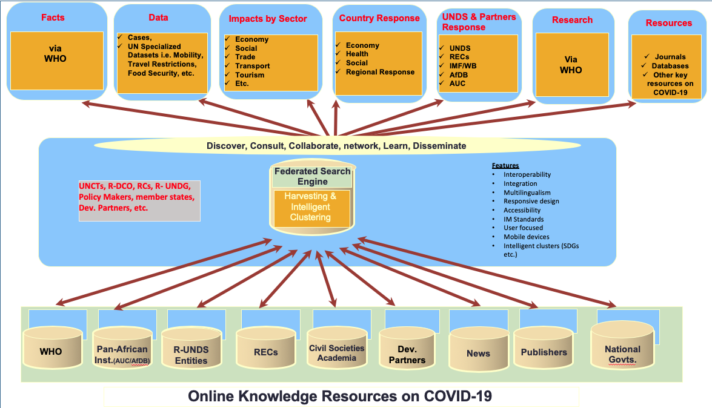
High-Level Architecture of Africa Knowledge Management Hub on COVID-19
Demo - https://knowledge.uneca.org/covid19/

Slide 15

Thank you

